Slide 1
Command Line and git

Slide 2
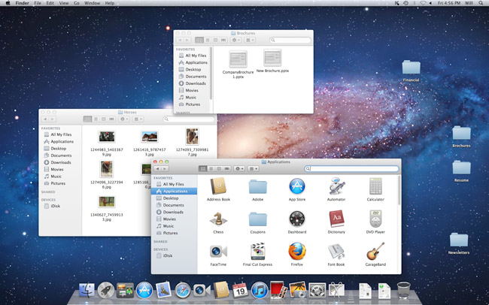
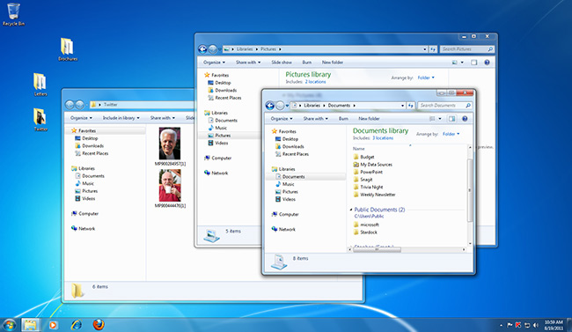
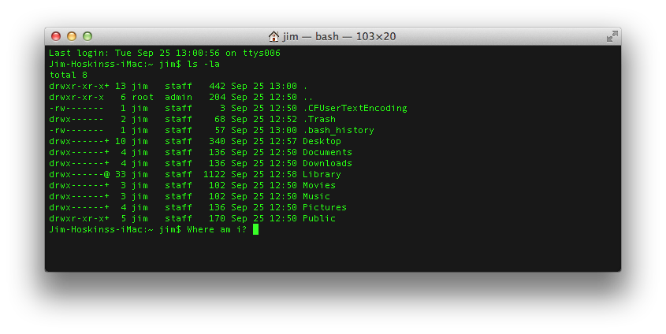
Graphical User Interface (GUI)
Command Line Interface (CLI)

Slide 3
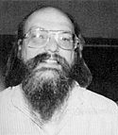
What is the command line?
Also known as a ‘shell’
Most common shell is bash (what we will use)
Bourne Again Shell (Ken Thompson give it up!)
Reimplementation of a shell from 1977
Every OS/X Mac
Every Linux box in the world
Every supercomputer
’Programming’ language itself
‘scripting’ language

Slide 4
Command line
Windows
Windows subsystem for linux (app store)
--or--
Start -> git -> git bash
Mac
Applications -> utilities -> terminal

Slide 5
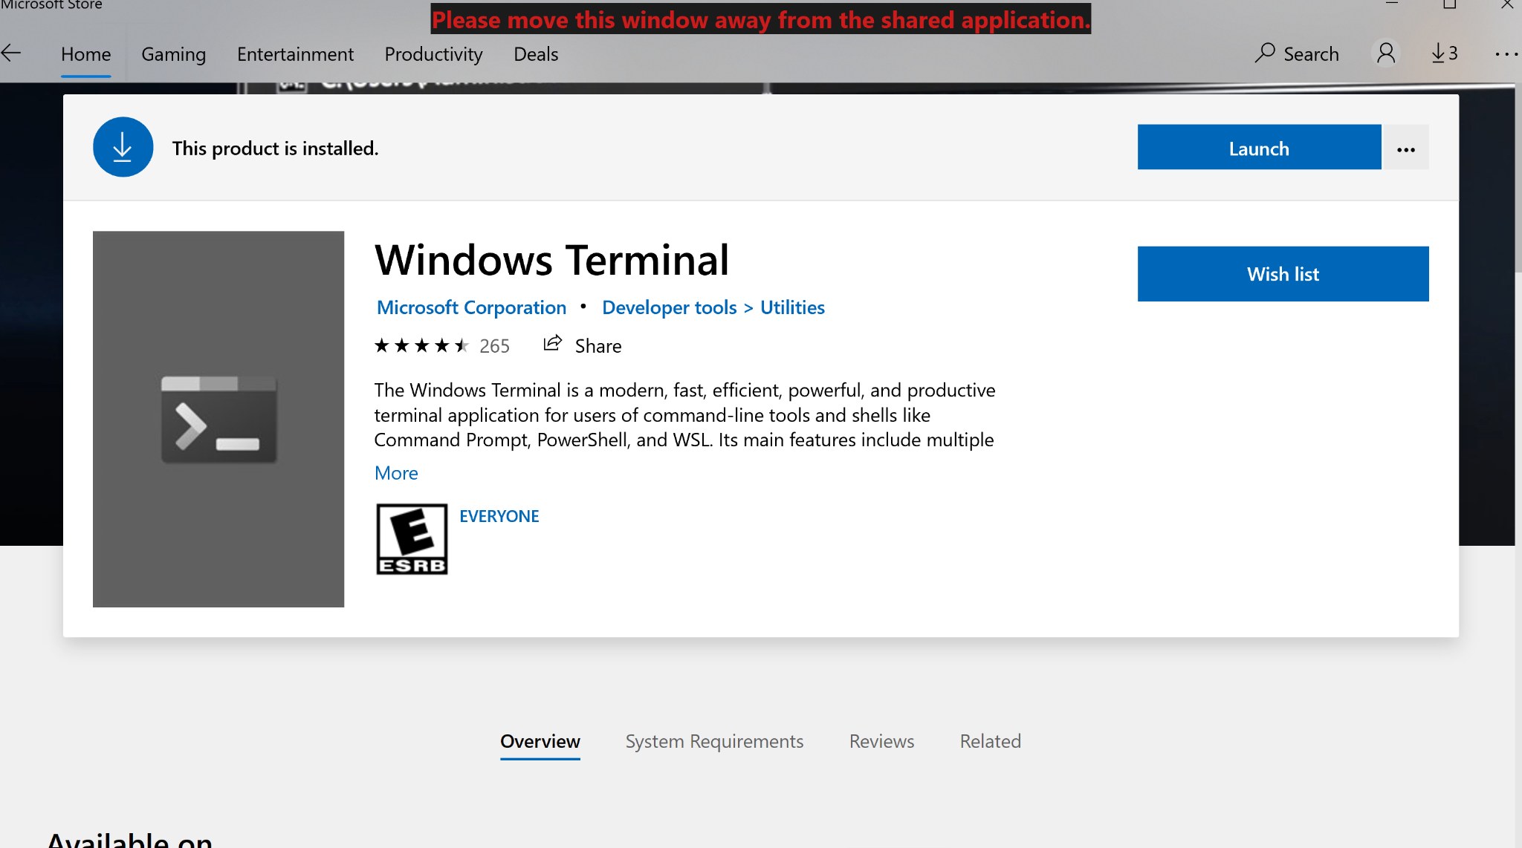

Slide 6
Command line
Tab completion is your friend
When entering file arguments
When entering directory paths
Hitting tab will autocomplete the filename!

Slide 7
https://www.codecademy.com/articles/command-line-commands
pwd
ls
ll
mkdir
touch
vi
rm
rm -rf

Slide 8
https://www.codecademy.com/articles/command-line-commands
mv
cp
rm
cd
cd -

Slide 9
What is git?
Git is the most popular version control software
Git is open source
Git runs on every platform
Git is better than all previous version control tools (although admittedly I’m not very good at it)

Slide 10
What is GitHub?
‘Git in the cloud’
Your git repository lives on GitHub.com
Other people can download and use your code
There is an issue tracker for your code
You can develop code collaboratively using GitHub
LETS LEARN BY DOING!!!

Slide 11
https://learngitbranching.js.org/
Clone your repo
Edit the README with a longer description
Stage the file
Make a new file requirements.txt
Write <pandas==0.12.4> in the first line
Stage the file
Commit both files with the message “my first commit”
Push to the cloud

Slide 12
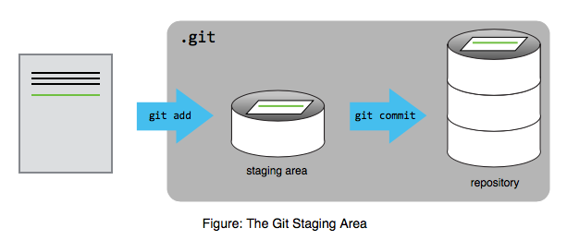

Slide 13
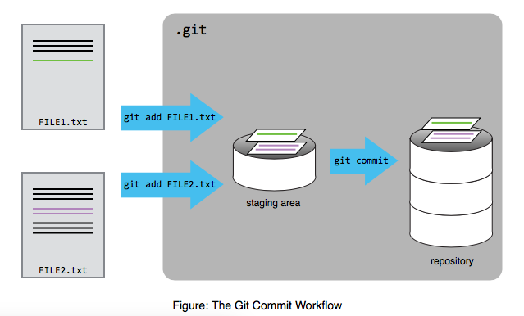

Slide 14
https://learngitbranching.js.org/
git clone <repo>
git init
git add .
git commit -m ‘commit message’
git push
git pull

